Slide 1
QA Testing Fundamentals
INFO6255 17115 Software Quality Contrl & Mgmt SEC 01 Fall 2019 [BOS-2-TR]
INFO6255 17943 Software Quality Contrl & Mgmt SEC 02 Fall 2019 [BOS-2-TR]
Fall 2019
Medi Servattalab
M.Servattalab@northeastern.edu

Slide 2

About me!!
My Name is Medi Servattalab (Medi Servat at work)
NU Alumni
30+ years of experience in IT (Development, Project Management and QA)
Worked in a lot of small and large companies in Mass
Currently live in Hopkinton, MA (the start of the Boston Marathon!!!)
Work at Fresenius Medical Care, Lexington MA for 14 years.
VP of Production Support Services
Interests: Tennis, Golf, Soccer and Running (Jogging!).

Slide 3

House Keeping Rules!!!!
Participate, Participate, Participate. Participate in the class….
If you show up physically in this class, be here mentally as well.
Show me what you got!
Your chance to improve your written & verbal communications
Missing classes: I rather not see any, however if you must take an absence let me know in advance. University Rules: 2X
Late shows: Please be on time or you will miss the quiz.
Laptops: I’d rather you close your laptops during the class, however you can use it if you must.
DO NOT HIDE behind your laptop.
DO NOT DO other class work during this class.
Phones/Watches: Silenced
Quiz: Most weeks there will be a quiz.
Don’t miss any.
Groups: You all will be placed in teams.

Slide 4
Teaching Assistants:
Two TAs can help you in this class:
Vaibhav Raj
eMail: raj.v@husky.neu.edu
Gauri Sarpotdar
Email: sarpotdar.g@husky.neu.edu
Slack Channel:
https://join.slack.com/t/info6255qasummer2019/shared_invite/enQtNjI3OTUxMzAzODc2LTRkMGY3MDcwMTgzNDhhZTVjODU1MGUzNzIwYjZjMWQ0YmQ0NTZkOWYxMTRiMTk4NDEwZjA2NzQwOTk4ZTEwNGU

Slide 5
What are you going to learn????
Week 1 | Introductions and the House Keeping rules
Week 2 | SDLC and the QA Life Cycle
Week 3 | Anatomy of a Test Plan/Strategy document
Week 4 | Analysis of Business & Functional Requirements/Test Condition Matrix/Traceability Matrix
Week 5 | Agile Methodology; DevOps Model;
Week 6 | Change and Release Management
Week 7 | Test Automation Project: MicroFocus UFT (Group Presentations)
Week 8 | Optimize Quality for Business Outcome Part1 and 2 – Assignment
Week 9 | Anatomies of Test Cases
Week 10 | Intro to ALM; Security Testing & Cyber Security
Week 11 | Cross Browser and Mobile testing; Usability & User Experience Testing
Week 12 | Test Automation Project: Selenium (Group Presentations)
Week 13 | Performance & Load Testing using Performance Center
Week 14 | Career Management; IT Leadership, Group Thinking; Motivation & Decision Making Skills
Week 15 | QA Job Positions & Job Interviewing Questions/Answers
Week 16 | Final Project Presentation (Group Presentations)

Slide 6
Course Assessment
Class Participation (10%) – Believe me 10% makes a difference!!!
Tests/Quizzes (30 %) – Short quizzes almost every week.
Timely Submission
Completeness & Correctness
Projects/Assignments (25%) – UFT/Selenium/Agile assignments for each group.
Final Exam – Project (35%) – Final project. Your team will do the following:
Test Condition Matrix/Test Scenarios/Test Cases/Traceability Matrix
Presentation
Test Plan

Slide 7
More on the Quizzes
There will be a quiz almost every week on the topics that were discussed the previous week.
The quizzes are Open Book, Open Notes, Open Blackboard.
Important Notes:
No talking; no discussing; no looking during the quizzes.
No copying and pasting of the answers. All answers must be typed in.
No pasting of the answers from the Web.
While taking a quiz, it is not the time for you to do research on the web.
Quizzes are Fixed lengths. If you go over the time, you will lose points.
Quizzes start around 6:05, 6:15 PM. If you are late or you are a no show you will miss the quiz.

Slide 8

About You!
Who are you?
What is your major?
Are you really technical?
What do you want to get out of this course?
When are you graduating?
Coop Experience?
Interests?
Career?

Slide 9
Moore’s Law – What is it?
This ‘law’ developed from the thinking of Gordon Moore, one of Intel’s founders, underpins much of the thinking and predictions about when our technology will become intelligent than us.
The simplified version of this law states that processor speeds, or overall processing power for computers will double every two years.
The simplified version of this law states that processor speeds, or overall processing power for computers will double every two years
https://humanswlord.wordpress.com/2014/01/14/brainfood-moores-law-explained/

Slide 10
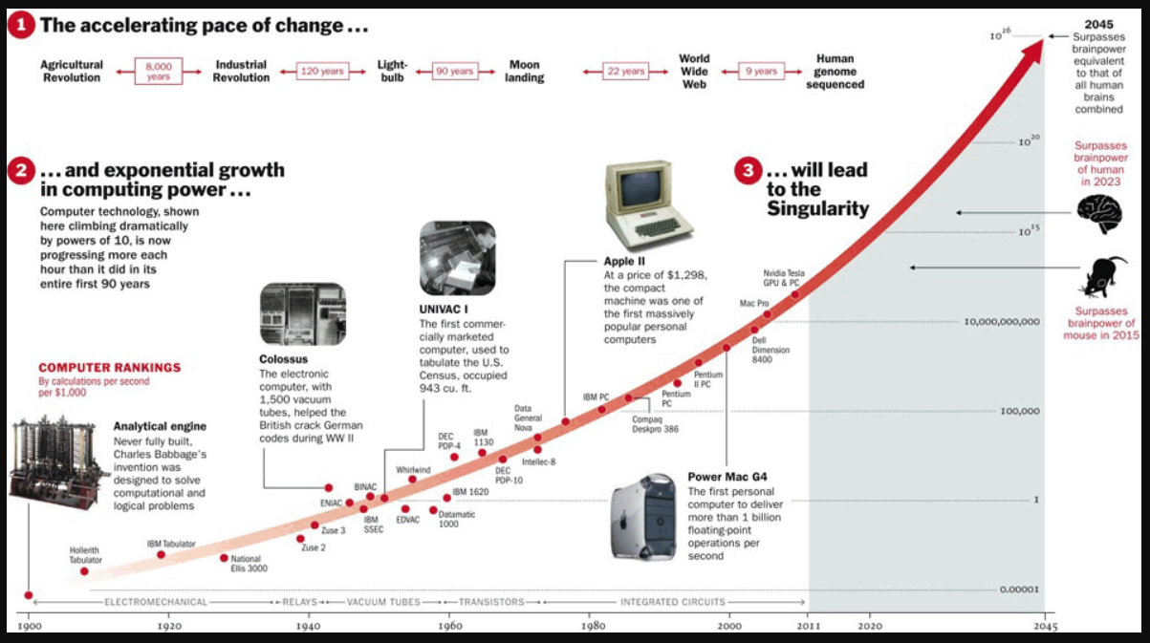

Slide 11

What does all of this really mean?
The Internet is getting bigger and more complicated every day!!
Software Applications will become more complicated!!
The testing will get more complicated!
There will be greater need for Software Developers and Software testers!!!

Slide 12
What makes a great QA Tester?
Do you know if you love QA?
Attributes of a great QA Analyst:
Great ‘Analytical Skills’
Great ‘Communication Skills’
Self Starter
What does the “Analytical Skills” really mean?
‘Analytical Skill’ is defined as the ability to visualize, articulate, conceptualize or solve both complex and uncomplicated problems by making decisions that are sensible given the available information.
“Communications Skills” – Why needed?
In Writing: to write test plans and test cases, defects and reports.
Verbal: to explain the test cases, test reasoning and the issues/problems.
“Self Starter”
Motivate yourself!!

Slide 13
QA - Theory vs Practice
This course is not about just a ‘theoretical’ Software testing.
This course is about a ‘practical’ QA testing.
This course is about different attributes of the software testing:
From my perspective & based on my experience
What skills I believe a QA resource should have
What kind of attitude a QA resource should have
A problem solver or a problem creator?
How well he/she works in a team environment?
Hard worker or a slacker?

Slide 14
Reviewing the Course Topics
What is Software testing?
Software testing is a process, to evaluate the functionality of a software application with an intent to find whether the developed software met the specified requirements or not. To identify the defects to ensure that the product is defect free in order to produce a quality product.
Software testing is an activity to check whether the actual results match the expected results and to ensure that the software system is Defect free.
Software Testing is the process of evaluating a system or its component(s) with the intent to find whether it satisfies the specified requirements or not.
Software testing is the process of evaluating a system with the intend of finding bugs. It is performed to check if the system satisfies its specified requirements.
https://artoftesting.com/manualTesting/what-is-software-testing.html
https://www.softwaretestingmaterial.com/software-testing/

Slide 15
Software Testing…
What is Software testing?
Software testing is a process, to evaluate the functionality of a software application with an intent to find whether the developed software met the specified requirements or not. To identify the defects to ensure that the product is defect free in order to produce a quality product.
The ‘Key points’:
It is a Process
Met the Specified Requirements or not
To Identify the Defects
The product is Defect Free? -
BTW - No software is defect free!

Slide 16
Reviewing the course topics
SDLC – QA Methodologies
Waterfall
Business Requirement vs. Functional Requirements?
Test Plan/Test Strategy
Test Condition Matrix
Traceability Matrix
Equivalence Class Partitioning
Test Coverage
Agile:
Epics, Sprints, Scrums, User Stories, etc.
Automation Testing
Performance/Load Testing
When do you know you are done with testing?

Slide 17
“Equivalence Class Partitioning”
It greatly reduces the number of test cases without compromising the test coverage or quality of testing.
It helps in reducing the overall test execution time due to reduced set of test data.
It is highly used in cases where exhaustive testing is not possible but at the same time test good coverage needs to be maintained.
Disadvantages of equivalence class partitioning
The identification of equivalence classes relies heavily on the expertise of the tester.
Having incorrectly identified equivalence classes leads to higher risk of defect leakage and less test coverage.
The equivalence classes needs to be partitioned just to the right amount and groups as having too large partitions leads to risk of missing defects.
Whereas, partitioning into more groups of smaller sizes leads to redundant tests.

Slide 18
More on the QA Methodologies
Waterfall vs. Agile
Business Requirements vs Functional Requirements
How to link the Requirements and the Test Cases and why?
How to create a traceability matrix to ensure accurate coverage
How to write test cases
How to conduct testing in Agile
What to do as part of the Sprints
More about Scrums, Sprints, QA role?

Slide 19
Testing Phases & Types
Manual Testing
Automation Testing
Load Testing
White Box Testing
Black Box Testing
Grey Box Testing
Security Testing
Vulnerability testing
Smoke Testing
Scalability Testing
Interoperability Testing
International/Localization Testing
Concurrency Testing
Unit Testing
Integration Testing
Functional Testing
System Testing
Stress Testing
Performance Testing
Usability Testing
Acceptance Testing
Regression Testing
Beta Testing
Longevity testing
User Roles Testing
https://www.inflectra.com/ideas/topic/testing-methodologies.aspx

Slide 20
More on QA…
Happy Path Testing: very simple flow testing (1 path).
Smoke Testing: A high level validation of the functionality.
Equivalence Partitioning: A technique to determine the minimum set of test cases that must be executed.
RAD Model: Rapid Application Development an iterative process.
Test Stub: A “dummy” routine to enable a function to be tested.
Test Harness: a pool of test stubs and test drivers put together.
Test Summary Report: A document showing the test results in a compacted format.

Slide 21
Reviewing the semester topics
How to write test plans and construct Test Cases
How the Waterfall and Agile processes work, and the phases associated with it.
Create a Traceability Matrix
Change vs. Release Management
QA Tools: ALM, Jira, UFT, Selenium, Performance Center (Two hands on assignments)
HP Optimize Quality for Business Outcomes…
Cross Browser Testing/Mobile Testing
Verbal and Written Communications
Security Testing & Cyber Security
Decision Making and Group Thinking
Job Interviewing Techniques
The Final Project (the eCare application)

Slide 22
QA Job Types
Different types of QA jobs:
Manual Tester – All tests are through the GUI or the application interface.
Automation Tester – Writes scripts for Automation testing using one of many tools in the market, e.g. Selenium, HP UFT, or other scripting languages.
Or – uses different languages to write scripts to test the interconnectivity of an application, such as (VB Scripting, Python, and etc.)
Data/Data Base Tester – All testing is done through writing and executing SQL statements or running various scripts for testing.
Performance & Load Tester – Performance, Load & Stress testing using one of many tools that are in the market. E.g. HP Performance Center.

Slide 23
QA Organizations Reporting Structure
QA is under the same umbrella as the Development
Reporting to the same VP or an Organizational head
Pros and Cons!!
Cons: May get swayed
QA is under a different organization than the Development
Reporting to a different VP or an Organizational head
Pros and Cons!!!
Pros: Independent and more free to conduct the testing

Slide 24
QA Terminology
Test Dashboard/Test Report – A matrix showing the test execution summary with pass/failure of the tests.
SIT – Systems Integration Testing done before the actual testing begins.
Unit Testing – Testing done by the development to ensure that their code functions as designed.
Integration Testing: Testing multiple components interfacing with each other.
Regression Testing – Repeating the running of the older test cases.
Manual Testing – Running the test cases by humans.
Automated Testing – Running the test cases using automated tools or scripting.

Slide 25
QA Terminology
Performance Testing – Running test to ensure that the product can function under a specified load.
Load and Stress Testing – Same as above. Stress testing goes above the Performance testing to find the level of failure.
Test Evidence/Test Results – Showing proof of testing by taking screen shots of the actual results.
Defects – Reporting the failure of the test cases to the development.
Defect Severity & Priority – The place in the queue for fixing and deploying into QA/Production.
Defect Process – Agreed upon process on how to handle the defects Reporting, prioritization and fixing.
Builds – Versioned code ready to be deployed into an environment.
Builds management – Includes tools to deliver the code to QA in a consistent and controlled manner, including versioning.

Slide 26
QA Terminology
Source Control – Using various tools to keep track of what goes into a build so a well measured and a solid build is delivered to QA.
Dev/QA/Prod Environments – QA environment is where the testing can be performed. It needs to be controlled from the code perspective and all builds into it are installed via Build Management software.
Test Data – Ensuring the test data exists in the QA database for testing.
Change Request – Change tickets that introduce changes to the frozen functionality.
QA Entrance/Exit Criteria – Conditions that allows the start and finish the testing cycle.
QA Testing tools – Running the testing using an automation tool as a regression test to speed up the process.
QA Signoff – QA end of testing.
Sprint – a small bundle of wish list items and the decisions on how to develop them.
Scrum – is the agile software development methods.

Slide 27
Top 3 QA Methodologies
Waterfall: the Waterfall model is widely considered the oldest of the structured SDLC methodologies. It’s also a very straightforward approach: finish one phase, then move on to the next. No going back. Each stage relies on information from the previous stage and has its own project plan.
Agile: The Agile model has been around for about a decade. But lately, it has become a major driving force behind software development in many organizations.
DevOps: The DevOps methodology is the newcomer to the SDLC scene. It emerged from two trends:
The application of Agile
Lean practices to operations work
and the general shift in business toward seeing the value of collaboration between development and operations staff at all stages of the SDLC process.
https://www.roberthalf.com/blog/salaries-and-skills/6-basic-sdlc-methodologies-which-one-is-best

Slide 28
Other QA Methodologies
Lean: The Lean model for software development is inspired by lean manufacturing practices and principles. The seven Lean principles (in this order) are:
Eliminate waste
Amplify learning
Decide as late possible
Deliver as fast as possible
Empower the team
Build integrity in
See the whole

Slide 29
Other QA Methodologies
Iterative: The Iterative model is repetition incarnate. Instead of starting with fully known requirements, project teams implement a set of software requirements, then test, evaluate and pinpoint further requirements. A new version of the software is produced with each phase, or iteration. Rinse and repeat until the complete system is ready.
Spiral: One of the most flexible SDLC methodologies, the Spiral model takes a cue from the Iterative model and its repetition; the project passes through four phases (planning, risk analysis, engineering and evaluation) over and over in a “spiral” until completed, allowing for multiple rounds of refinement.

Slide 30

What is a Use Case?
Use Case is another way of defining functional requirements.
It introduces an Actor who will perform various functions in the application.
It shows the interaction of the Actor with the system or an application.
The advantage is that it allows for better understanding of the process flow when an Actor is involved.
There could be multiple Actors describing the Use Cases from different user perspectives.
Use Cases are not User Stories. User Stories are short descriptions of what the customers do within the application.

Slide 31
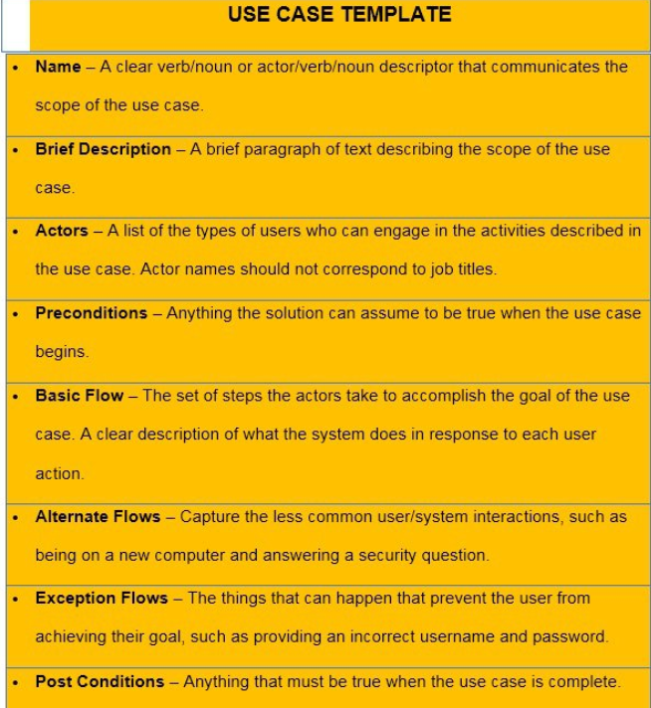

Slide 32
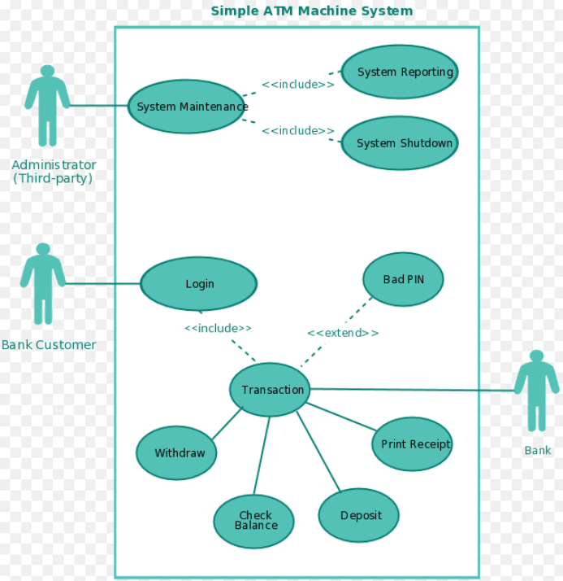
Use Case Diagram example

Slide 33
More on QA…
POC: Proof of Concept. A prototype.
Test Log: Keeping a log of the test execution during testing.
User Story: A user/customer function that results into a system function (equivalent to a Functional Requirement).
Walkthrough: A review session to walk through a test plan, test cases or performing a Code Walkthrough to go through the code.

Slide 34
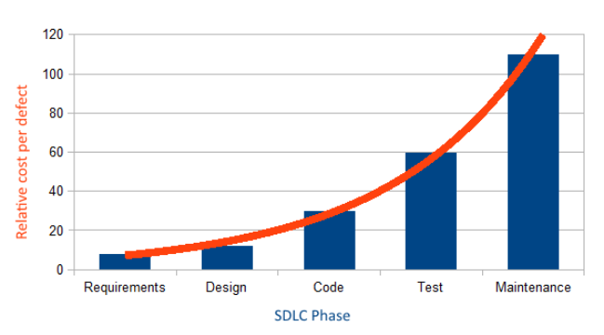
Cost of Defects

Slide 35
Verification vs. Validation
Verification comes early on in the project to verify the
Functional Requirements
Code Inspections & Walkthroughs
Application Design
Validation comes later in the project during the actual testing. It includes all phases of the testing:
Functional Testing
Integrations Testing
End to End or System Testing
UAT

Slide 36
Web Based Testing
Web Based Application Testing
Typical topology: Client -> Web Server -> App Server -> DB
Thin-Client vs. Thick-Client testing
Thin-Client – most processing is happening on the Server side
Thick-Client – Most processing is happening on the Client side (Java Applets and ActiveX controls on the Client side)
Advantages and disadvantages
Thick Client: Performance testing focus
Thin Client: Less of a performance issues risks

Slide 37

Web Based Application
Testing Considerations:
Browser Testing: Test as many as browsers as specified in the support document.
Functionality Testing: The functions are working?
Integration Testing: Are all interfaces working?
Usability and User Interface testing
Security Testing: Role based testing
Load and performance testing: For ensuring performance meets the SLAs
Printing
Caching
File Upload/Download

Slide 38
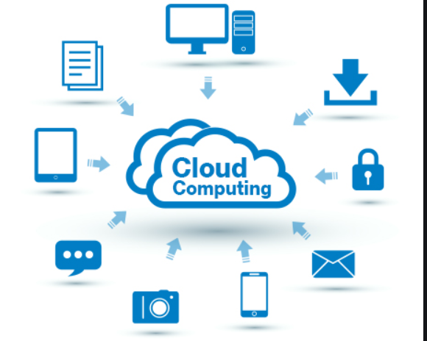
Cloud Computing
What is the Cloud?
“the practice of using a network of remote servers hosted on the Internet to store, manage, and process data, rather than a local server or a personal computer”

Slide 39
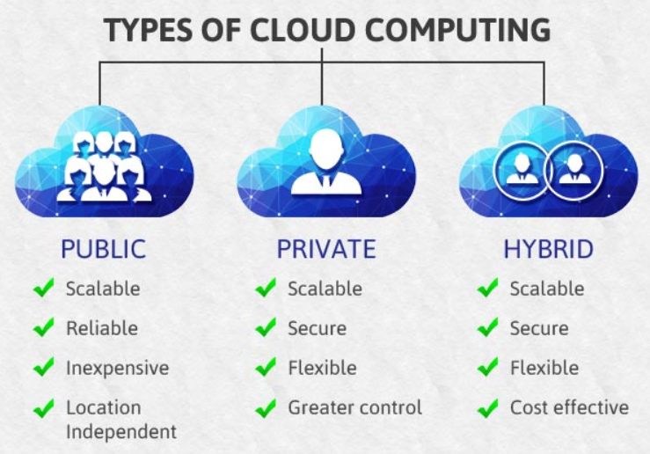
The Cloud Types
Private Cloud – Operated for the organization only.
Community Cloud – Shared by specific community
Public Cloud – Available to the public
Hybrid Cloud – Combining two or more clouds

Slide 40
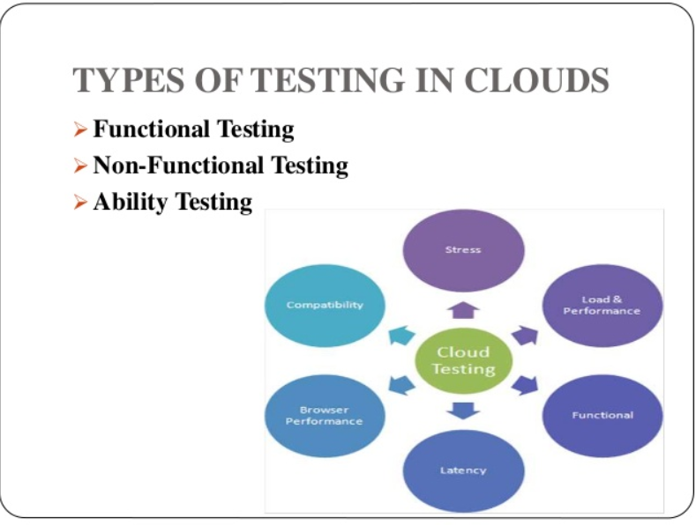
Cloud Testing Types
Testing in the Cloud
Performance Testing
Security Testing
Availability Testing
External API testing

Slide 41
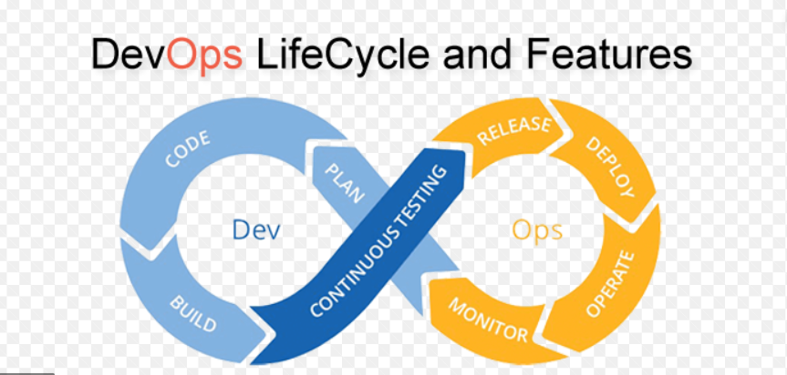
DevOps Methodology

Slide 42
DevOps
The word 'DevOps' is a combination of two words 'development' and 'operations.'
Why is it important?
Frequent new builds per day rather than per week
Stability, reliability and Security for all code builds
All major companies (google, Facebook, etc.) deliver world class builds into production
Seamless integrated model:
Code Development -> Automated Test Environment -> Test Team executes the Automated tests -> Deploy into Production
The DevOps key to success is ‘Automation’

Slide 43
Back End Testing
We will discuss this more
DB Testing
API Testing
Interface Testing

